Slide 1
High budget CAD Workstation
By Jeremie Guerchon, Ali Zoubeidi, Vincent Bryant Benesen

Slide 2
Outline
What’s a CAD Computer?
The difference between CAD and CAM
Parts of the PC
Motherboard
CPU
CPU Cooler
Memory
PSU
Case
GPU
Case
Price Reveal
Softwares
AutoCad
SolidWorks

Slide 3
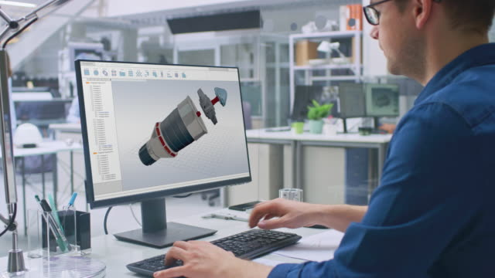
What is a CAD Computer?

Slide 4
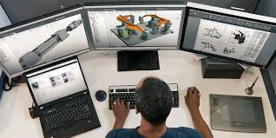
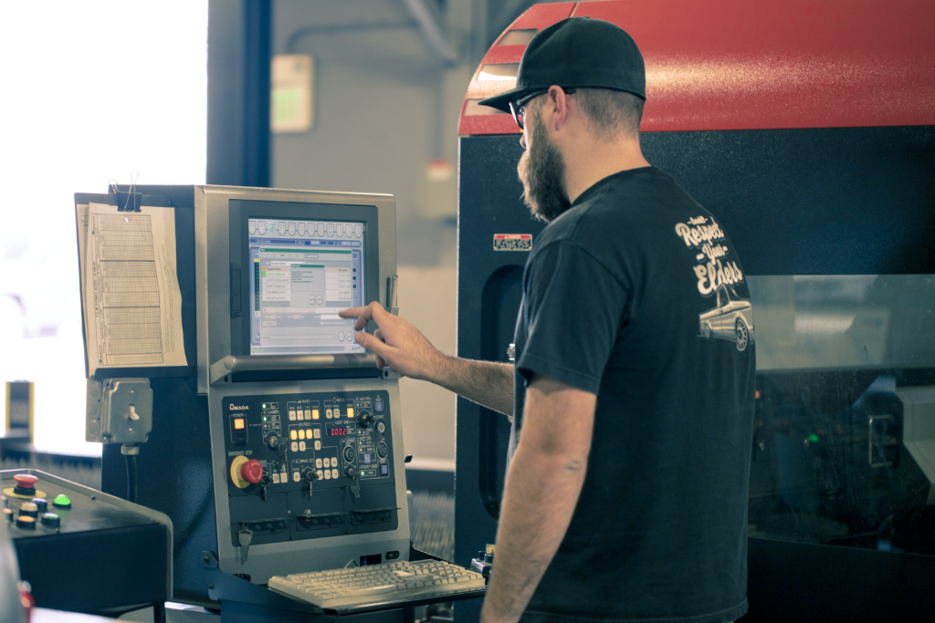
CAD VS CAM

Slide 5
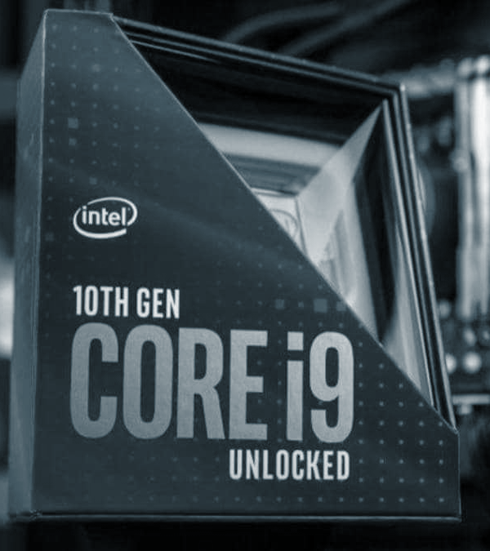
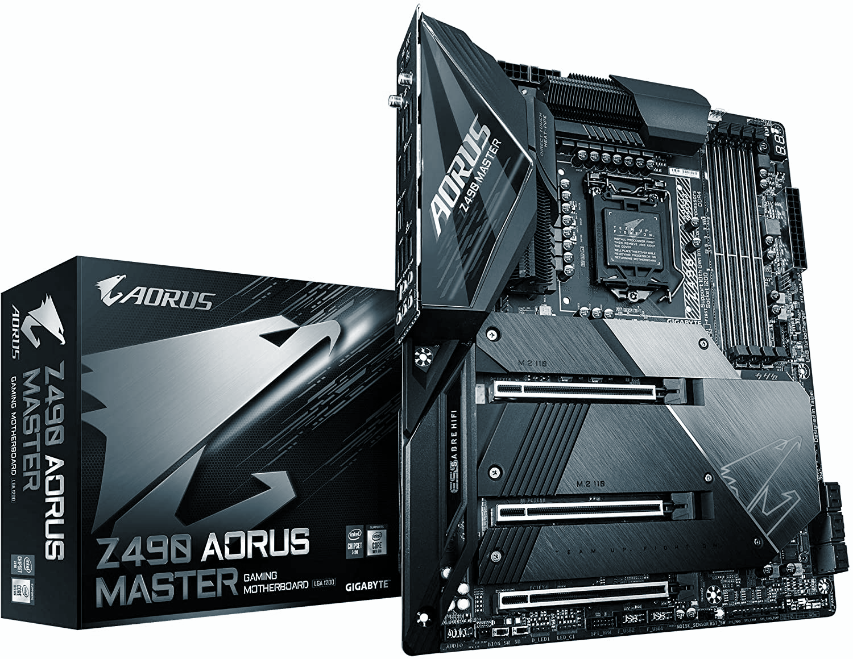
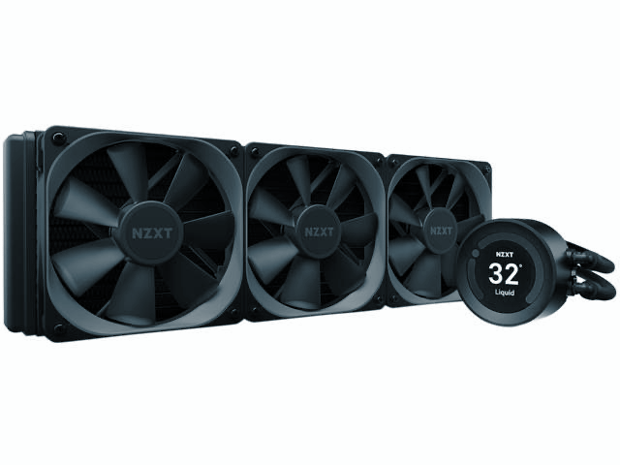
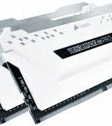
PC PARTS
Notes:
Requirements for the CAD/CAM computer

Slide 6
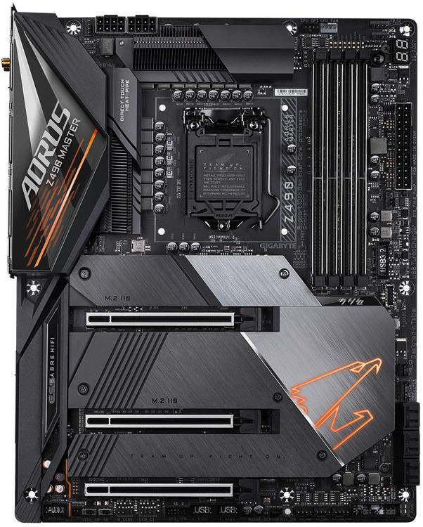
Motherboard
Memory Slots
4
PCI-E x16 Slots
3
SATA
6
USB 2.0 Headers
2
USB 3.2 Gen 1 Headers
1
USB 3.2 Gen 2 Headers
1
Wireless Networking
Wifi 6
Manufacturer
Gigabyte
Socket
LGA 1200
Form
ATX
Chipset
Intel Z490
Memory Max
128 Gb
Memory Type
DDR4
Does not support ECC
RAID Support

Slide 7
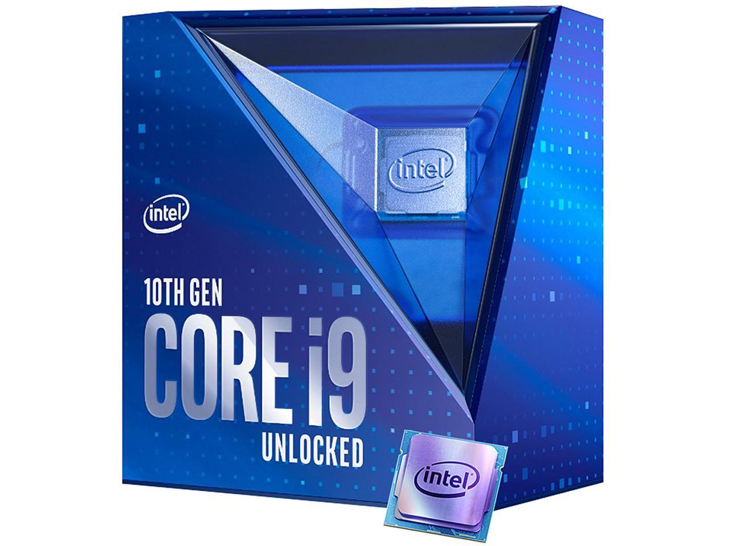
CPU
Socket
FCLGA 1200
Base clock
37. GHz
Max overclock
5.3 GHz
Bus Speed
8GT/s
Max Memory Size
128 Gb
Memory Channels
2
4K support at 60 Hz
Processor Graphics CV FROM DG
Intel UHD Graphics 630
Max Resolution
4096x2304 @60Hz
Number of Displays Supported
3

Slide 8
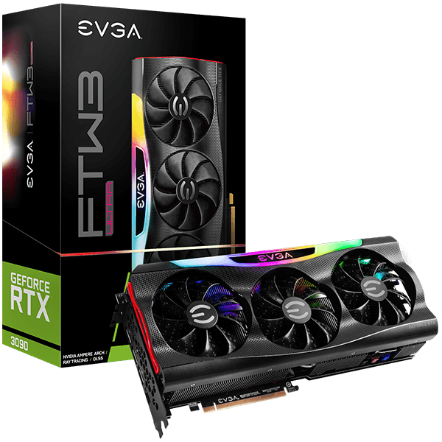
GPU
Boost Clock
1800 MHz
Memory Clock
19500 MHz Effective
CUDA Cores
10496
Bus Type
PCIe 4.0
Memory Detail
24576 MB GDDR6X
Memory Bit Width
384 Bit
Memory Bandwidth
936 GB/s

Slide 9
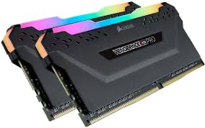
Memory
Memory Type
DDR4
Capacity
32GB Kit (2 x 16 GB)
Tested Latency
16-18-18-36
Tested Voltage
1.35V
Tested Speed
3200MHz
Led Lighting RGB
SPD Latency
15-15-15-36
SPD Speed
2133MHz
SPD Voltage
1.2V
Speed Rating
PC4-25600 (32000MHz)
Performance Profile
XMP 2.0
Package Memory Pin
288

Slide 10
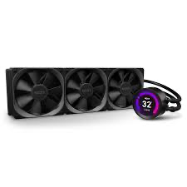
CPU Cooler
Tube Length
400mm
Tube Material
Ultra-low Evaporation Rubber With Nylon Braided Sleeve
Fans
Aer P120
Compatible Socket
Intel Socket LGA 1200, 1151, 1150, 1155, 1156, 1366, 2011, 2011-3, 2066

Slide 11
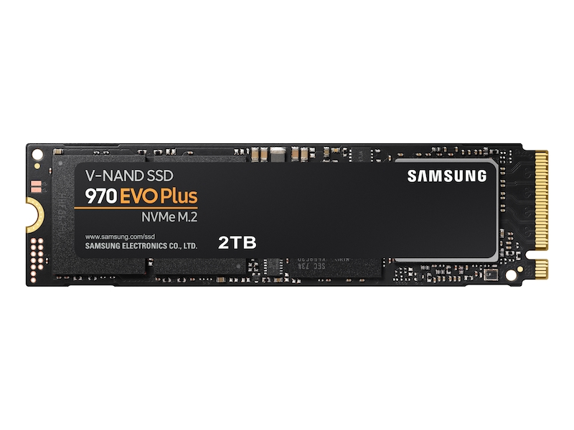
Storage
Product Type
SSD
Series
970 Evo plus
Interface
PCIe Gen 3.0 x4, NVMe 1.3
Capacity
2Tb
Key Features
Sequential read speed up to 3,500 Mb/s
Sequential write speed up to 3,500 Mb/s

Slide 12
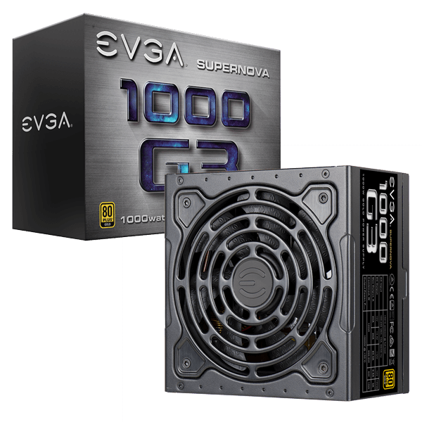
Power Supply Unit
1000W + 50C
Cooling slide
Air
Small size
BIG PERFORMANCE
Hydraulic Dynamic Bearing Fan
Modular Design
80 PLUS GOLD EFFICIENCY
EVGA ECO MODE

Slide 13
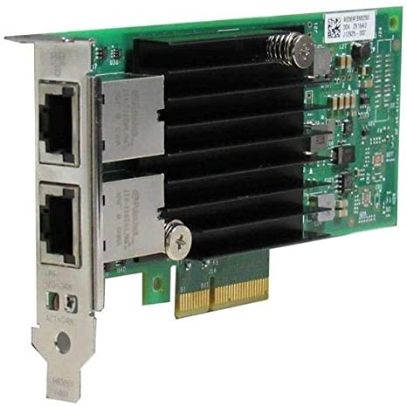
Network Adapter
Intel Ethernet Converged Network Adapter X550-T2
500 series
Dual Port Configuration
X550 Controller
Speed
8.0 GT/s, x 4 lane
System Interface
PCIe v3.0 (8.0 GT/s)

Slide 14
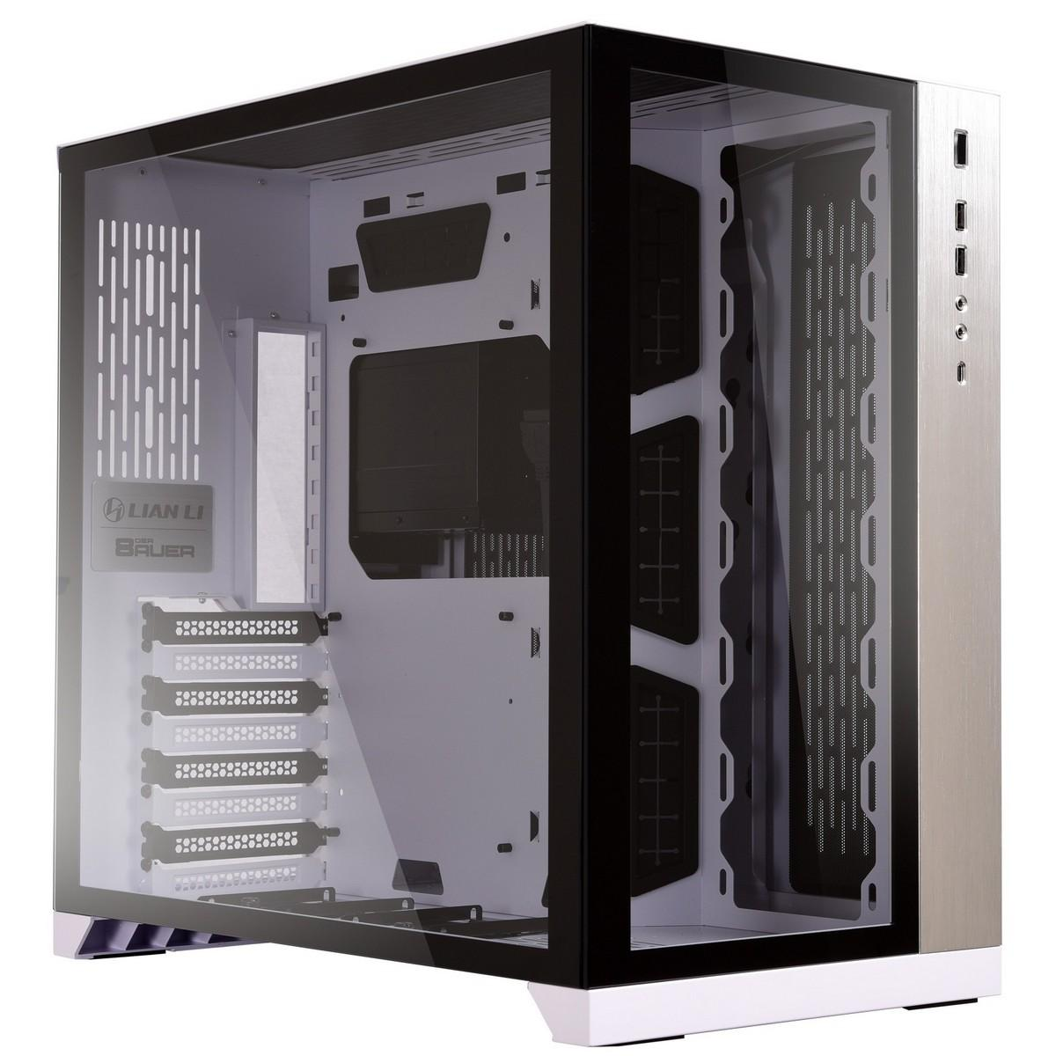
Computer Case
Lian Li PC-O11 Dynamic ATX Full Tower Case
Generally considered to be a good case for high budget builds
Type-C (USB 3.1) 1280MB/S
Lots of space for radiators
Double PSUs capability
Double layered cable management
Up to 6 SSD, and 3 HDD
Tempered Glass

Slide 15
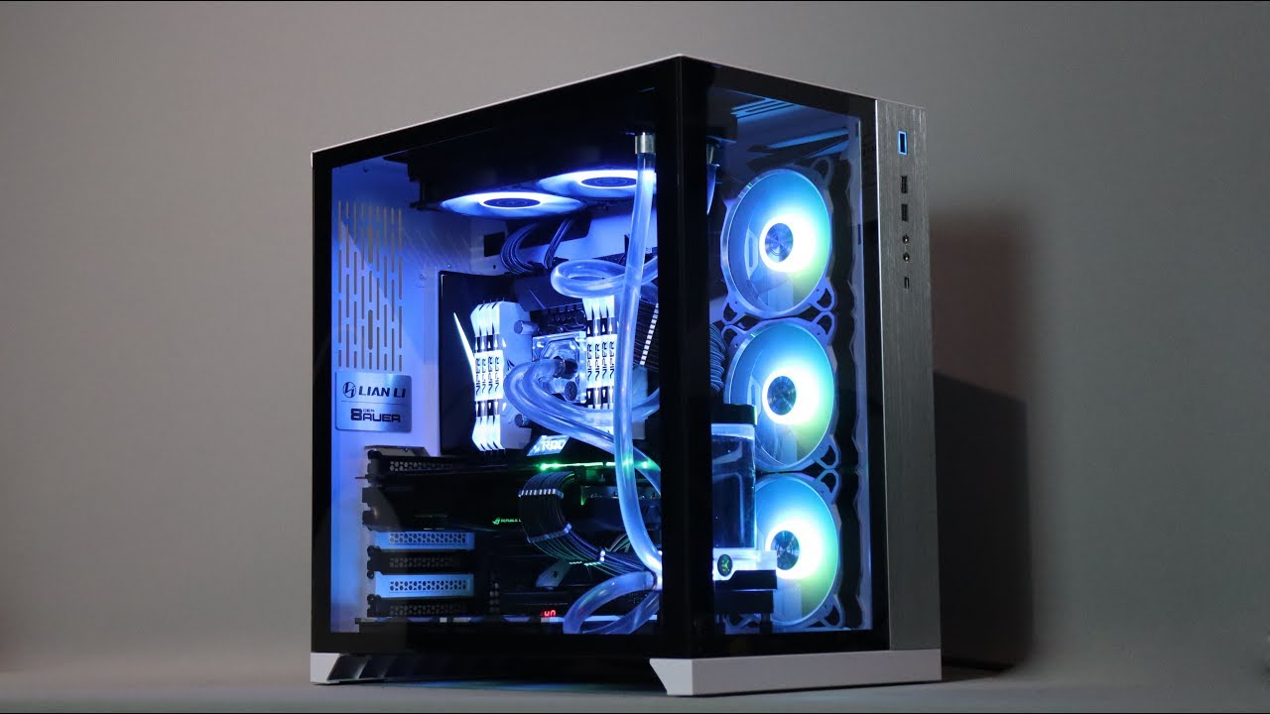
Total Price
6,672,37 Canadian dollars

Slide 16
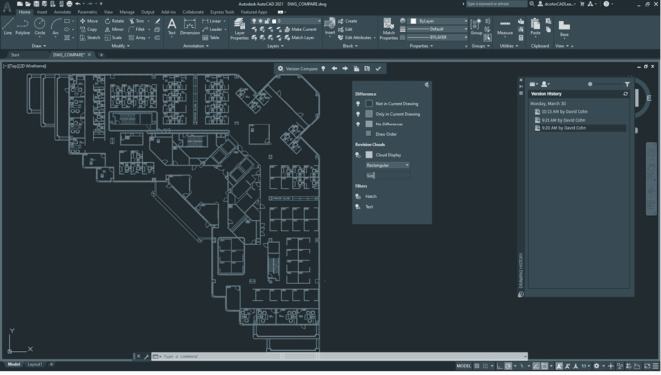
SOFTWARES

Slide 17

AutoCAD
AutoCAD is a computer-aided design software developed by the company Autodesk (hence the name AutoCAD). It allows you to draw and edit digital 2D and 3D designs more quickly and easily than you could by hand.

Slide 18

SolidWorks
Is used to develop mechatronics systems from beginning to end.

Slide 19
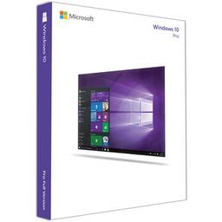
Windows 10 Pro OEM 64-Bit
Mode
64-bit
Features
Device encryption
User management
Remote Desktop Access

Slide 20
THE END

Slide 21
References
https://www.evga.com/products/product.aspx?pn=220-G3-1000-X1
https://ark.intel.com/content/www/us/en/ark/products/88209/intel-ethernet-converged-network-adapter-x550-t2.html
https://www.nzxt.com/products/kraken-z73
https://www.samsung.com/us/computing/memory-storage/solid-state-drives/ssd-970-evo-plus-nvme-m-2-2-tb-mz-v7s2t0b-am/
https://www.intel.ca/content/www/ca/en/products/processors/core/i9-processors/i9-10900k.html
https://www.gigabyte.com/Motherboard/Z490-AORUS-MASTER-rev-1x#kf
https://www.evga.com/products/product.aspx?pn=24G-P5-3987-KR

Slide 22
https://www.lian-li.com/pc-o11-dynamic/
https://www.amazon.ca/Corsair-Vengeance-2x16GB-PC4-28800-Optimized/dp/B082DGZJ9C
https://www.autodesk.ca/en
https://my.solidworks.com/try-solidworks?mktid=13830&utm_campaign=202007_nam_sw_GoogleSWOPT_en_XOP2051_rise_brand_ca_exact&utm_medium=cpc&utm_source=google&utm_content=search&utm_term=EAIaIQobChMIupifvLiZ7QIVTMqzCh0WmwRLEAAYASAAEgJ-v_D_BwE&gclid=EAIaIQobChMIupifvLiZ7QIVTMqzCh0WmwRLEAAYASAAEgJ-v_D_BwE&gclsrc=aw.ds

